Slide 1
Things exist.
People exist.
People all die.

Slide 2
Religions attempt to answer:
How did everything get here?
Why am I here?
What am I supposed to do?
What happens when I die?

Slide 3
Animism – Belief that many things in nature have their own spirit.
-Native Americans
-Sub Sahara Africans
-Japanese
-Shintoism

Slide 4
Hinduism
3rd largest religion in the world. Primarily in India and Nepal.
About 1 Billion Hindus in the world today.
Believe in many gods, who are all a manifestation of a Supreme God.
Do not have one holy book, but have several writings that give guidance. (The Vedas and the Great Epics.)

Slide 5
Hinduism - Basic Beliefs
- Reincarnation – a person’s soul is reborn as another living thing.
Karma – people who live a good life will be born into a higher caste.
Castes – People are born into a social class.
Cows are sacred. Hindus do not eat beef.
Ganges River is sacred, washes away evil.

Slide 6
Buddhism
Founded by Siddhartha Gautama who later became known as the Buddha, or Enlightened One.
Primarily practiced in Tibet, Japan, Thailand and China.
Do not believe in a Supreme Being and do not have a holy book.
Believe the cause of suffering is one’s own selfish desires.
Believe selfish desires can be overcome by the Eightfold Path.

Slide 7
Buddhism

Slide 8
Islam
Founded by Mohammed around 600 AD
Primarily in the Middle East and South and Southeast Asia.
Muslims believe in one God named Allah.
The Koran (Qu’ran) is the holy book.
Five Pillars of Faith – basic duties Muslims must fulfill.

Slide 9
Islam – Five Pillars of Faith
All Muslims must:
believe there is no other God but Allah.
pray five times a day toward Mecca.
give money to the poor.
fast during the month of Ramadan.
make a pilgrimage to Mecca.

Slide 10
Judaism
First religion to teach monotheism.
History of Judaism is recorded in the Old Testament of the Bible.
The Torah is the Jewish holy book.
The Ten Commandments were given to Moses as an outline for worship and right living.
God is described as a God of love who cares for and protects his people, while also holding them accountable for their sins.

Slide 11
The Ten Commandments
1. Do not have other gods besides me.
2. Do not worship idols.
3. Do not misuse God’s name.
4. Keep the Sabbath day holy.
5. Honor your father and mother.
6. Do not murder.
7. Do not commit adultery.
8. Do not steal.
9. Do not lie.
10. Do not covet.

Slide 12
Christianity
Monotheistic religion. Christians believe in the same God as followers of Judaism.
Founded by Jesus 2,000 years ago.
Teaches God is the Creator of all things who loves and cares for people.
The Bible is the holy book of Christianity.

Slide 13
Christians Believe:
God gave humans rules about how to live.
When people did not follow his commandments, God sent his son Jesus to pay for people’s sins by dying for them.
Anyone who believes Jesus died to pay for their sins can live forever with God in Heaven.

Slide 14
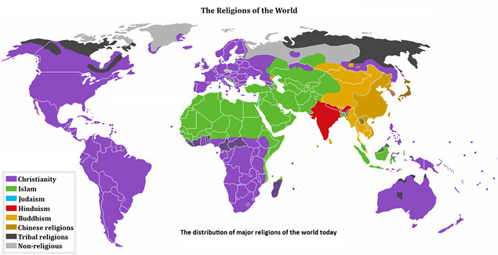
Distribution of World Religions

Slide 15
